Slide 1
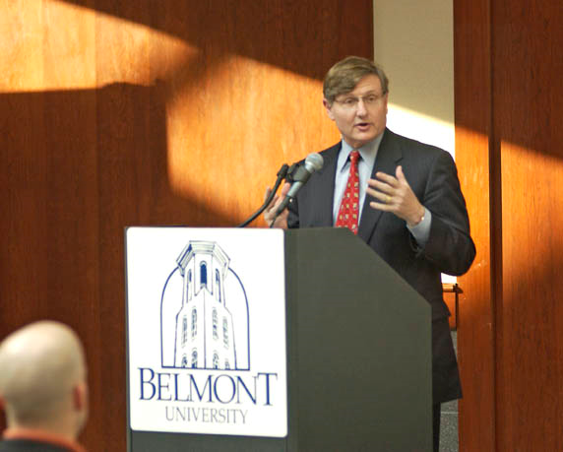

DYNAMIC DELIVERY
LESSON SIX

Slide 2
WHAT OR HOW?
“Great speakers are not born, they’re trained.”
It’s not what you said; it’s how you said it.
What: 30%
How: 70%

Slide 3
Contents
Body language
Communication styles
Analysis of sample delivery

Slide 4
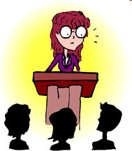
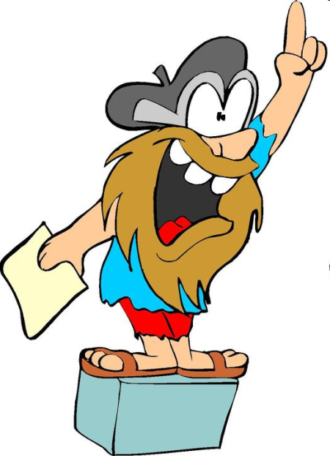

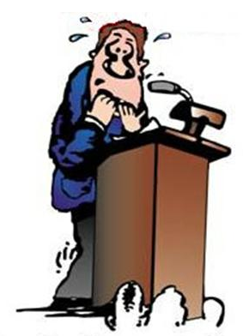
BODY LANGUAGE
Be aware of your personal appearance, your posture, gestures and facial expressions.
Distant
Confident
Nervous
Aggressive

Slide 5
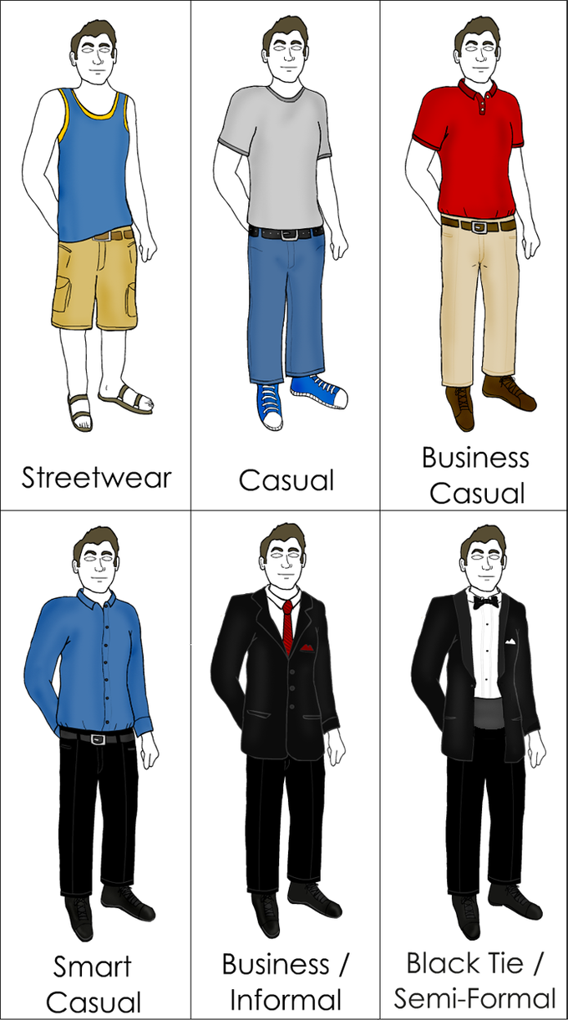
BODY LANGUAGE
PERSONAL APPEARANCE
Be respectful
Be relevant

Slide 6
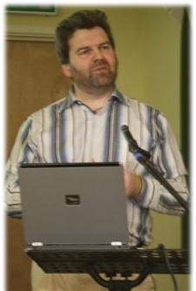
BODY LANGUAGE
PERSONAL APPEARANCE
It needs to be trimmed!
It needs to be shaved!
It needs to be button and with a tie!
He’s too informal!

Slide 7

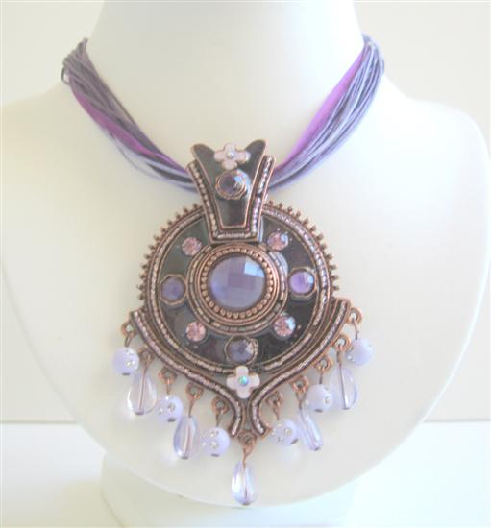
BODY LANGUAGE
PERSONAL APPEARANCE
His tie’s so loud!
Such an impressive one!

Slide 8
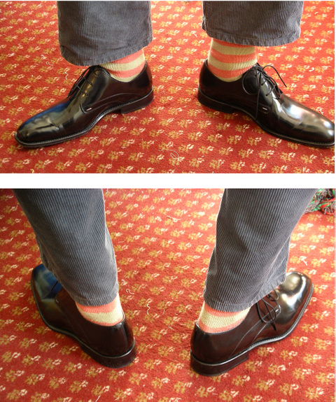
BODY LANGUAGE
PERSONAL APPEARANCE
Look at his socks!

Slide 9


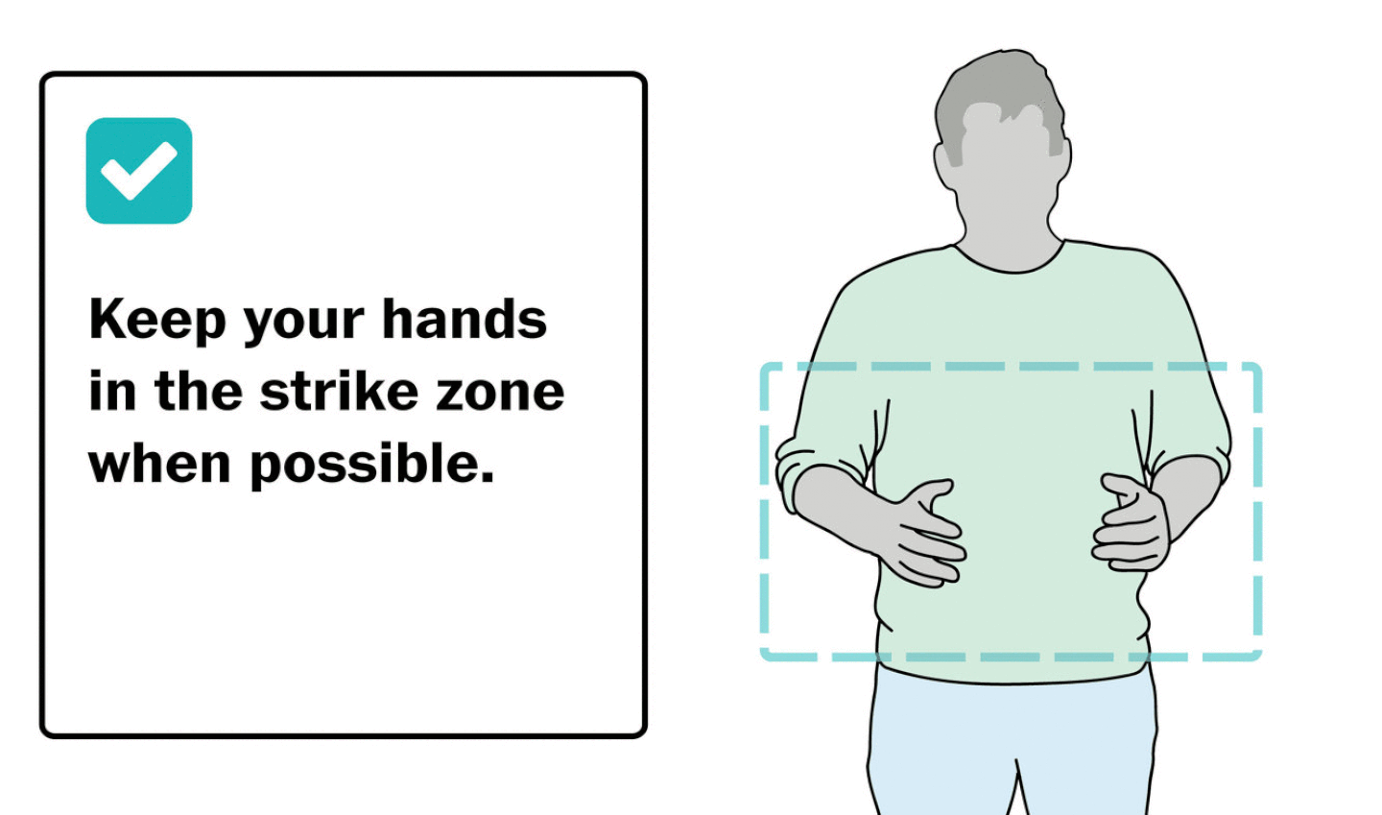
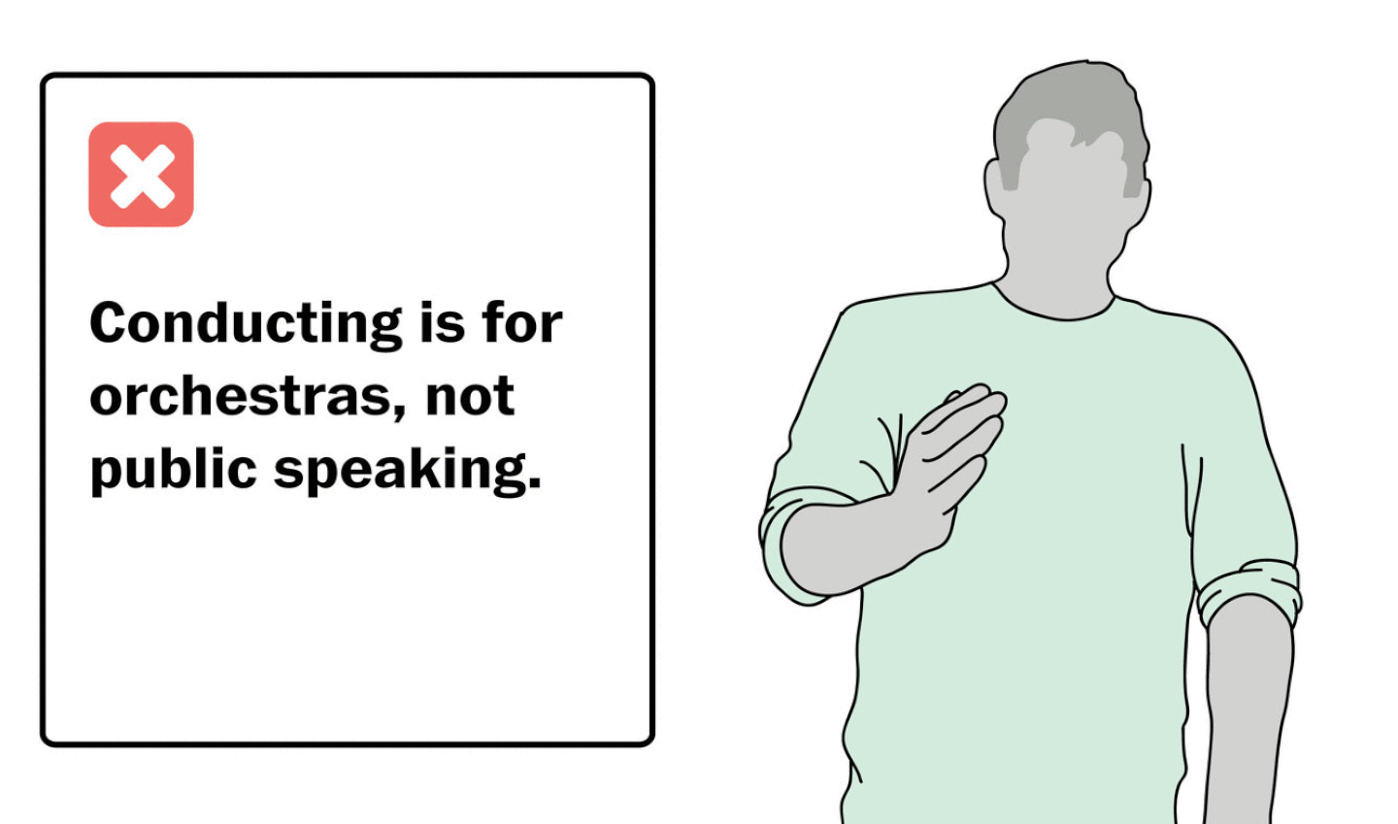
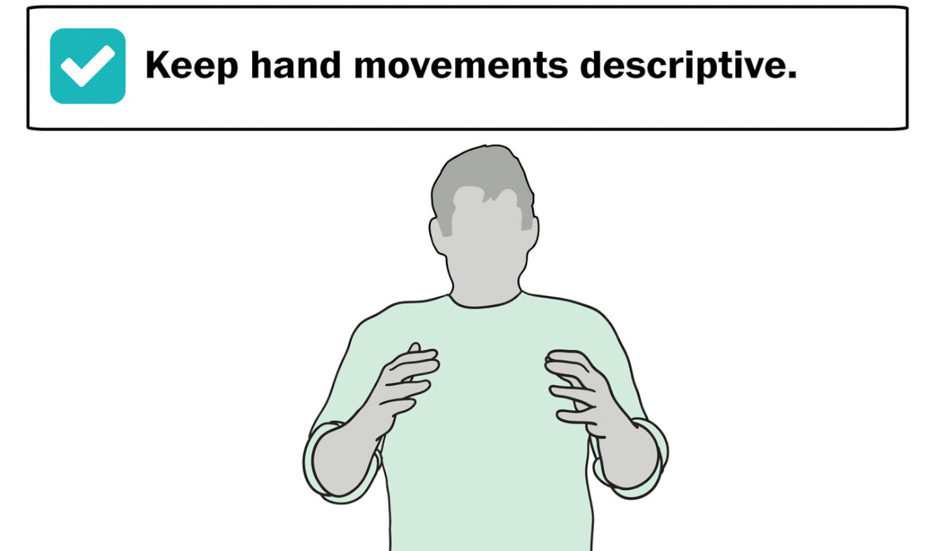
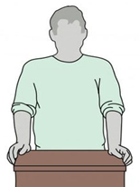
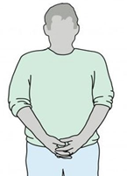
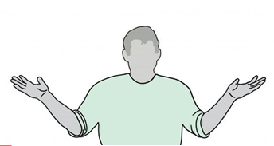
Gestures & Postures
BODY LANGUAGE
Comfortable
Dominant
Descriptive
Unconfident
Confident
Nervous

Slide 10

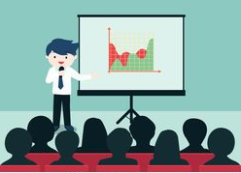

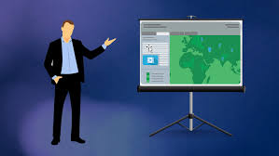
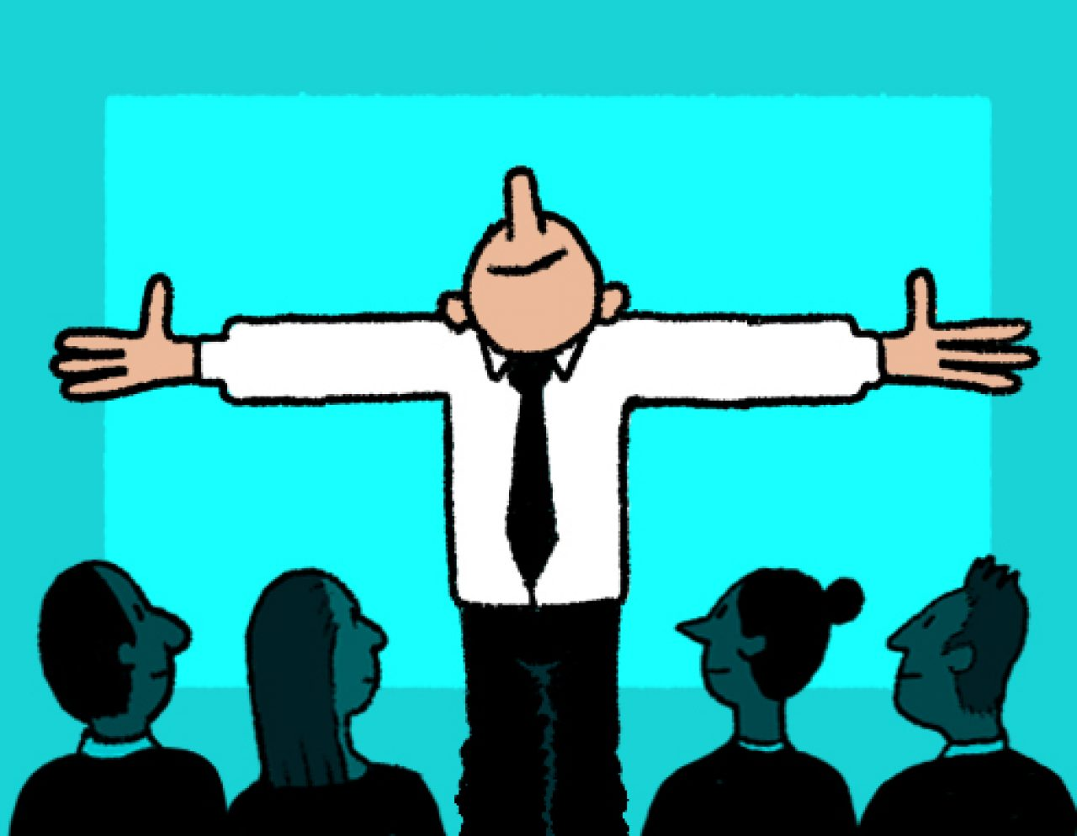
BODY LANGUAGE
Where and how to stand?

Slide 11
Gestures & Postures
BODY LANGUAGE
DO NOT:
Constantly adjust glasses
Pop the top of a pen
Lean on anything for support
Play with jewelry
Lick or bite your lips
Use too many gestures
Keep hands in your pockets
Keep hands ‘handcuffed’ behind your back
Keep arms crossed
Wring hands nervously
Playing with your hair

Slide 12

Communication Styles
BODY LANGUAGE
Nonassertive
Assertive
Aggressive
Notes:
12

Slide 13
BODY LANGUAGE
Communication Styles
Communication Style Nonverbal Behavior Verbal Behavior
Nonassertive
Little eye contact
Downward glances
Slumped postures
Wringing hands
Weak voice
Qualifiers (maybe, kind of…)
Fillers (uh, you know, well, so…)
Negaters (It’s really not that important, I’m not sure…)

Slide 14
BODY LANGUAGE
Communication Styles
Communication Style Nonverbal Behavior Verbal Behavior
Assertive
Good eye contact
Comfortable posture
Strong, audible voice
Facial expressions matched to message
Appropriate tone
Direct and clear language
Use of ‘I’ statements and cooperative ‘we statements

Slide 15
BODY LANGUAGE
Communication Styles
Communication Style Nonverbal Behavior Verbal Behavior
Aggressive
Glaring eye contact
Moving too close
Threatening gestures (pointing finger, clenched fist)
Loud voice
Swear words and abusive language;
Sexist or racists terms;
Explicit threats

Slide 16
Activity
Now you watch a presentation and take notes of any weak points.

Slide 17
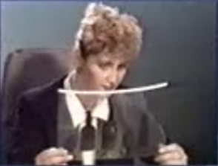
Activity
Now you watch the presentation again and take notes of improvements.

Slide 18
Group Presentation – Week 8
Make a group of four/five.
Prepare a group presentation on a chosen topic:
1. A policy/law that solved/failed to solve a problem in a specific community.
Contents: 1) background leading to the policy/law
2) activities/implementation
3) gains/reasons for losses
Presenter 1: Introduction + Conclusion
Presenter 2: Point 1
Presenter 3: Point 2
Presenter 4: Point 3

Slide 19
Submission: script + slides
Folder: Names of all members
https://drive.google.com/drive/folders/1M31IcUGwYr1vvh7hH0RB5T2Ei9OJrUug?usp=sharing
Link to submit the slide design in Week 6
https://drive.google.com/drive/folders/1at0l8tyYcWzSH5tmCYE2XH6px3VYiIkT?usp=sharing

